Slide 1
Introduction to Machine Learning

Slide 2
Before Starting the Course
Upon completion of this course, you will have acquired general knowledge of introductory artificial intelligence algorithms and data analysis.
The person receiving the course needs to practice a lot in order to learn the subject better after the lesson.
Slides will mostly be explained with images rather than text. That is why it is extremely important to take notes during the lesson.
Since the titles are sufficient for basic algorithms, the titles should be researched, lots of applications should be coded and research should be done on sites containing theoretical information.

Slide 3
What You Will Learn In This Course
What is Machine Learning?
What innovations has Machine Learning brought to our lives?
What are the requirements and additional capabilities for Machine Learning?
What is Data Science?
What is data cleaning, provisioning and attribute engineering?
What are the steps of a Machine Learning project?
What are the tools used in Machine Learning?
What are useful resources for Machine Learning?
Hands-on Training: What does a machine learning project look like?

Slide 4
Mert Çobanov
Github: cobanov
Linkedin: mertcobanoglu
Twitter: mertcobanov

Slide 5


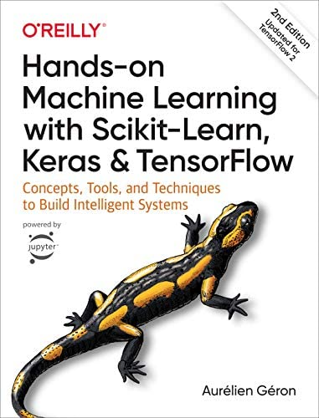
Kaynaklar
Deep Learning Türkiye
Hands-on Machine Learning with Scikit-Learn, Keras & TensorFlow
Aurelien Geron
Stanford University
stanford.edu/~shervine/
Shervine Amidi

Slide 6
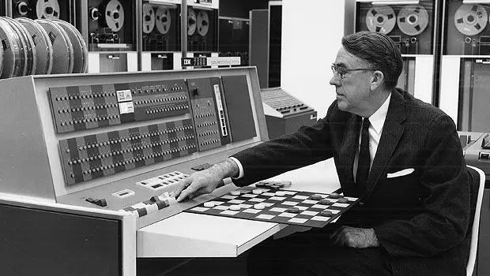
What is Machine Learning?
Machine Learning is the science (and art) of programming computers so that they can learn from data.
Machine Learning is the field of study that gives computers the ability to learn without being explicitly programmed.
—Arthur Samuel, 1959

Slide 7
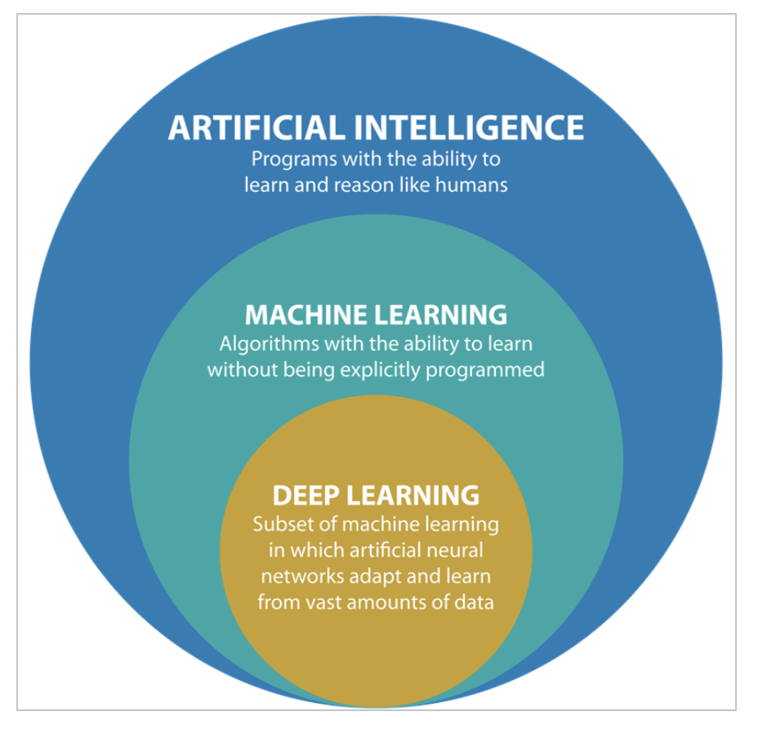
Machine Learning Disambiguation

Slide 8
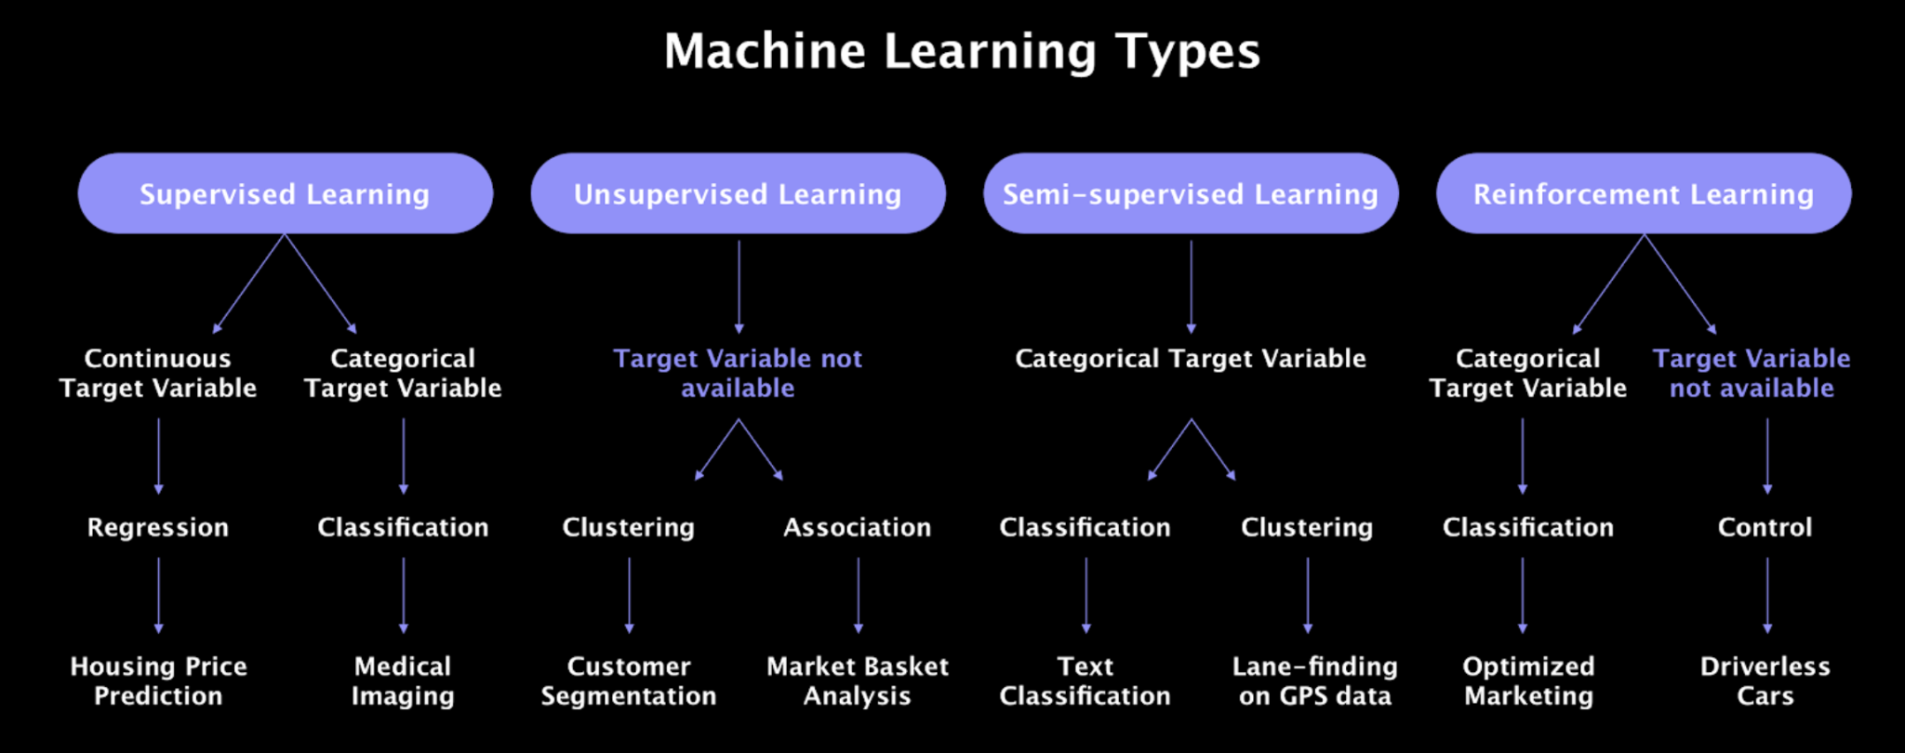
Types of Machine Learning

Slide 9
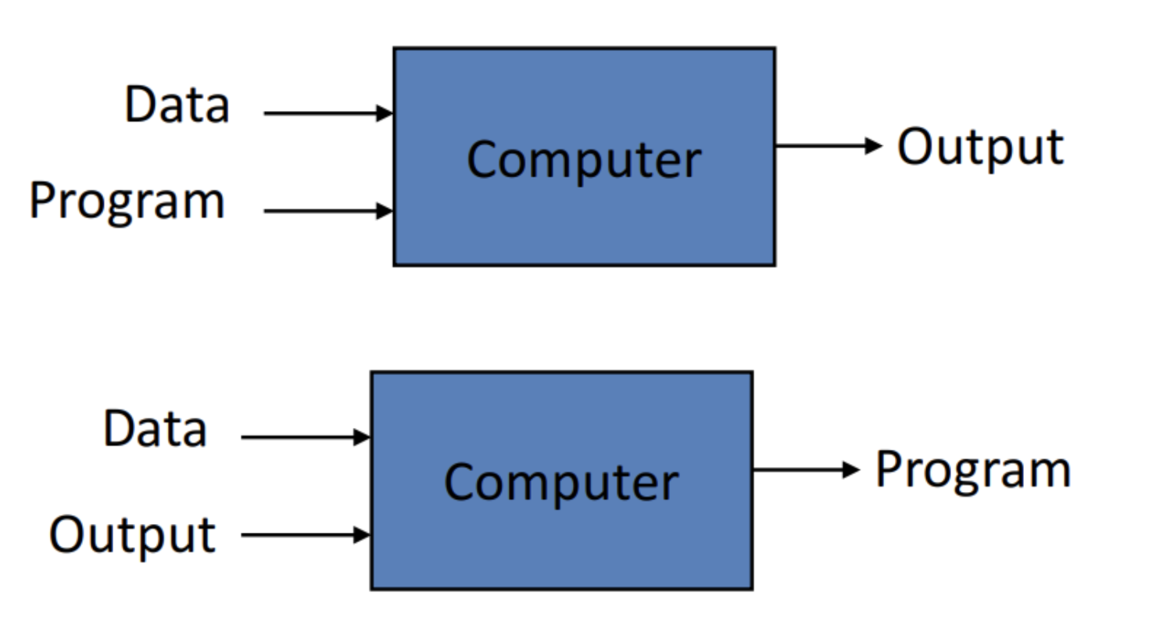
Machine Learning Comparison

Slide 10
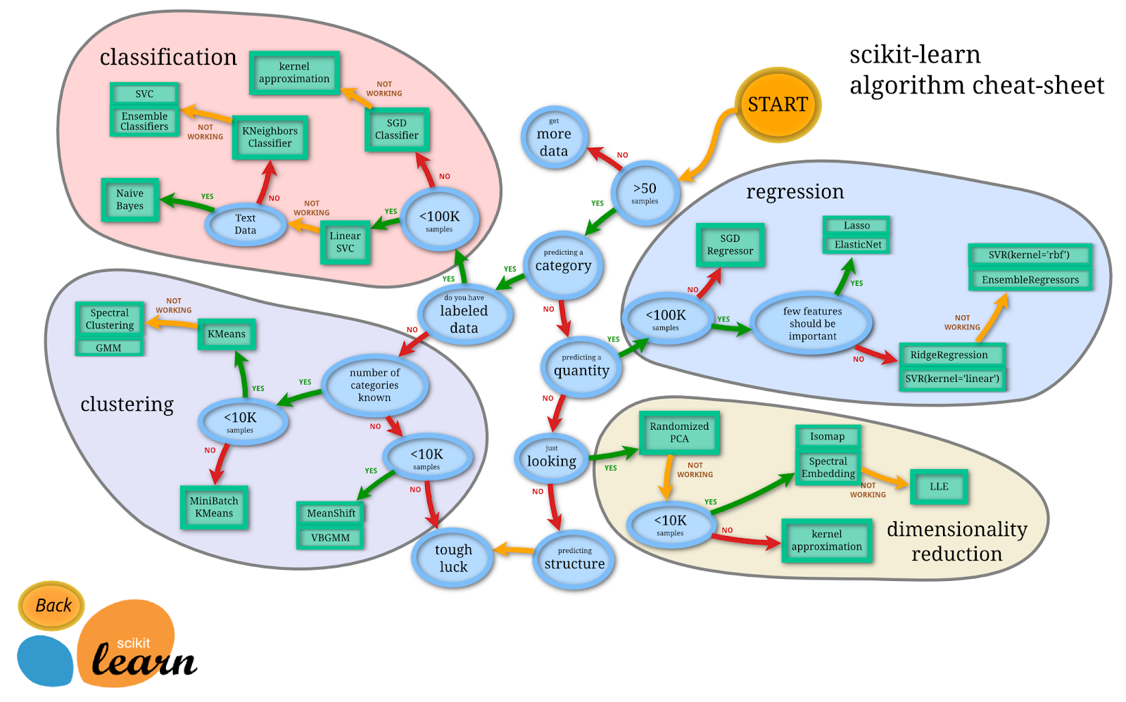
Machine Learning Algorithms

Slide 11
Machine Learning Applications
Segment customers based on their purchases so you can design a different marketing strategy for each segment
Suggesting a product that a customer might be interested in based on past purchases
Analyzing images of products on a production line to automatically classify
Automatically categorize the news
Automatically flag offensive comments on discussion forums
Create a chatbot or personal assistant
Predict your company's revenue for the next year based on many performance metrics
Making your app respond to voice commands
Creating a smart bot for a game

Slide 12
Mathematics in Machine Learning

Slide 13
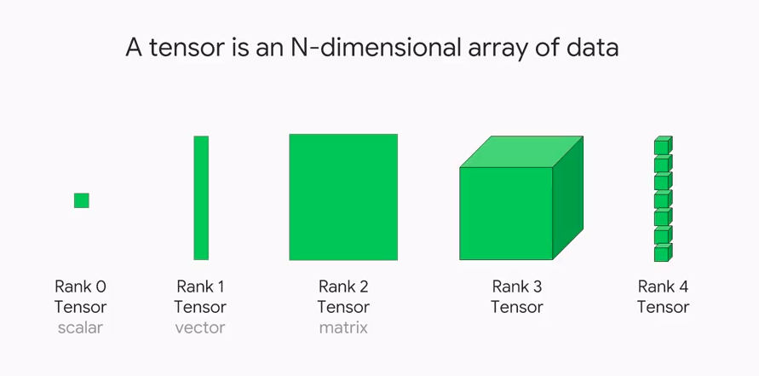
Linear Algebra

Slide 14
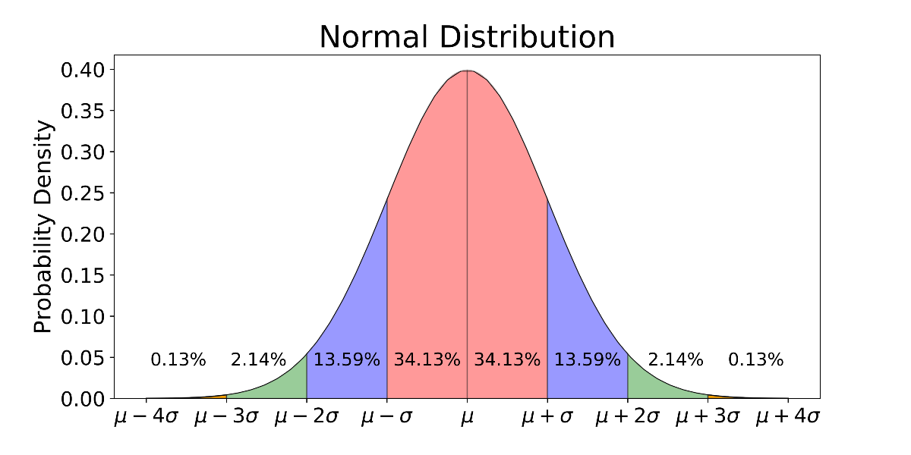
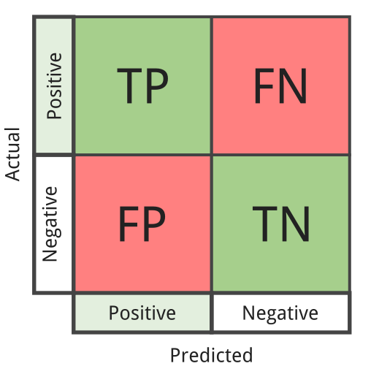
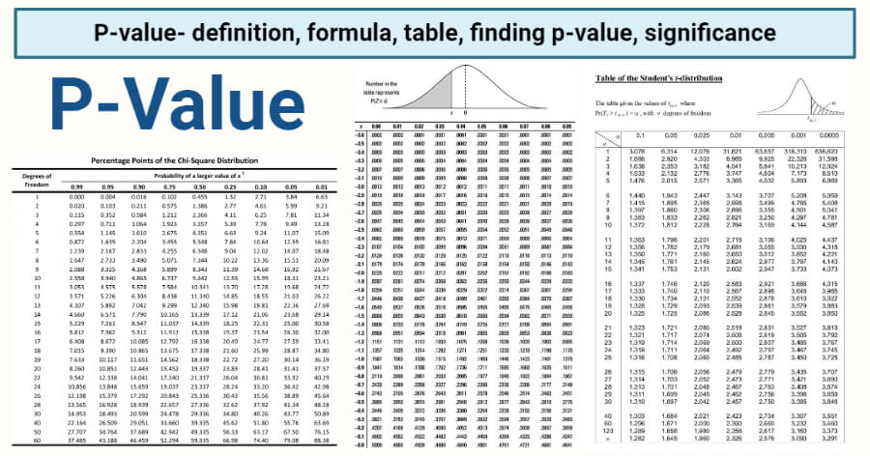
Probability and Statistics
Distributions
Model Performance Measurements
Descriptive Statistics and Statistics Tests

Slide 15
Data Science

Slide 16
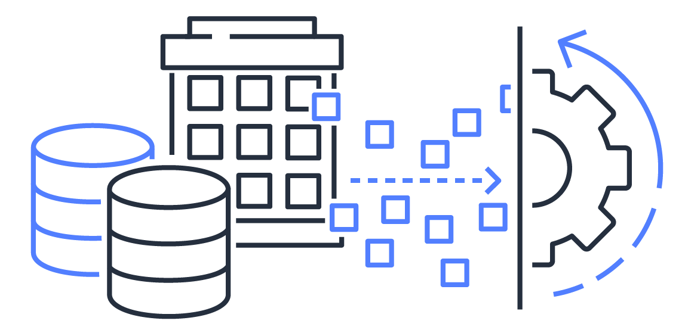
Working with Data
Data science is a multidisciplinary field that uses scientific methods, processes, algorithms and systems to extract information and insights from structured and unstructured data.
Data science is a concept used to combine statistics, data analysis, machine learning and related methods to understand and analyze real events with data. It uses many techniques and theories from fields such as mathematics, statistics, computer science.

Slide 17
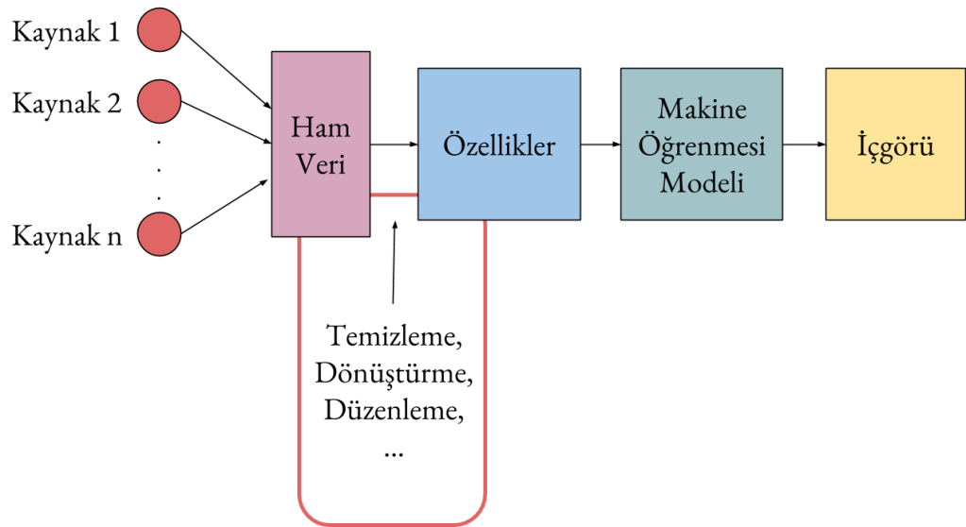
Feature Engineering
Feature engineering is the process of using domain knowledge to extract features from raw data. Features are used by predictive models and affect results.

Slide 18
Model Training

Slide 19
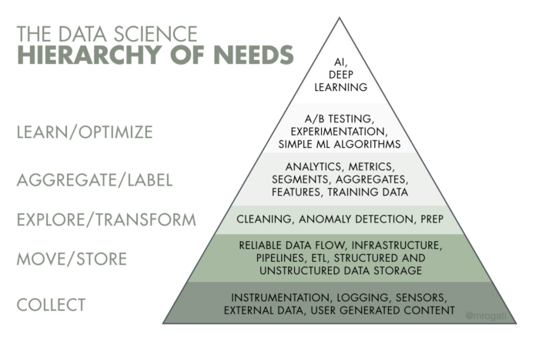
Machine Learning Project Steps
Seeing the big picture and understanding the project
Collect data
Examine and visualize data
Fitting Data to Machine Learning Models
Model selection and training of the model
Optimizing the model
Integrating the model into the system

Slide 20

Big picture and understanding the project
Define the goal in terms of business
What are the current solutions/workarounds?
How should you evaluate this issue (supervised/unsupervised, online/offline etc.)?
How should performance be measured?
What would be the minimum performance required to meet the business goal?
Is human expertise available?
How do you fix the problem manually?
List the assumptions you (or others) have made so far

Slide 21
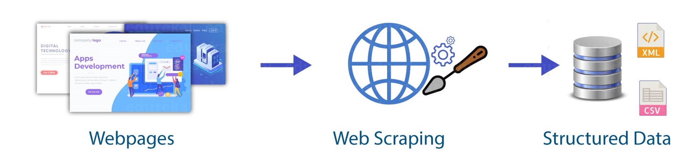
Collect Data
Prepare a Working Environment
Data should be stored neatly and appropriately in machine learning projects. In particular, the raw data should not be damaged and their structures should not be damaged. The data to be used and pre processed in the model should be stored and the data sent to the model should be stored. Therefore, appropriate databases should be established or folder hierarchies should be provided.
Get the Data
There are many sources that can obtain data, data sets obtained from the internet can be used during learning stages, working with real-world data sets is a bit more difficult, sometimes this data is not easy to obtain, but these data can be collected over the internet with software.

Slide 22
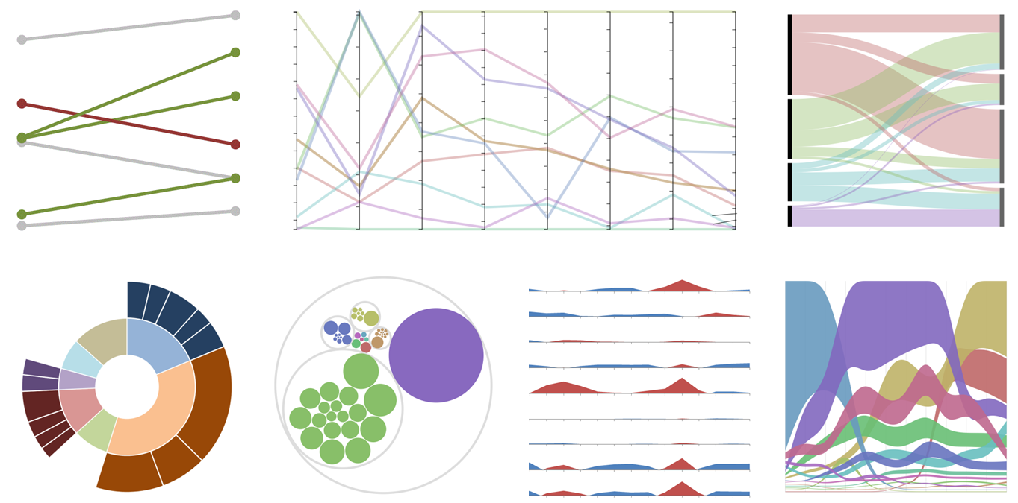
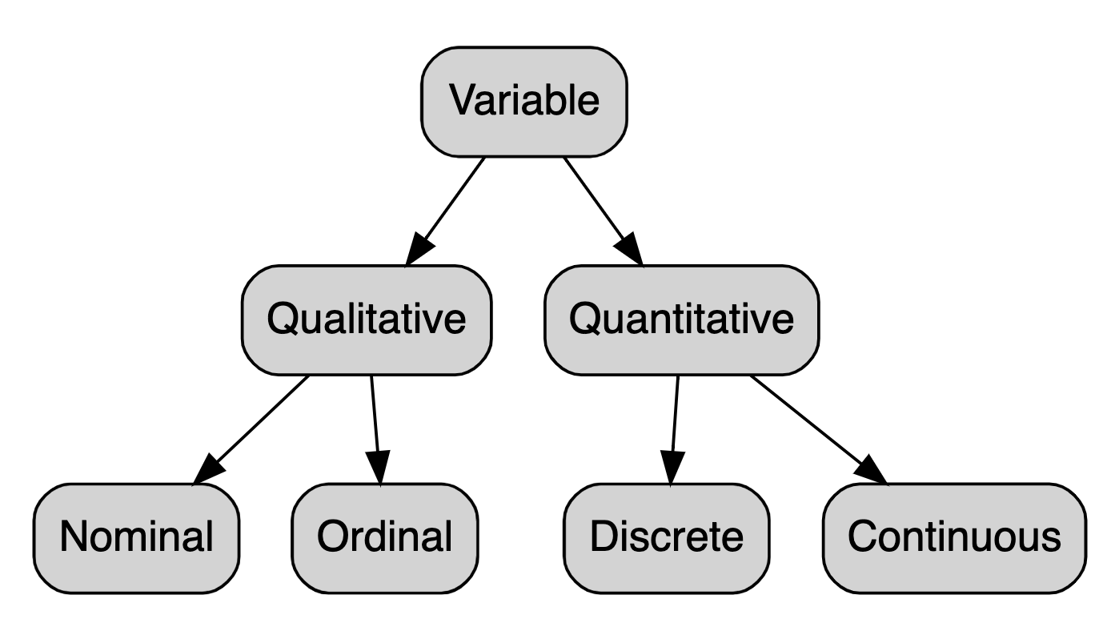
Examine and Visualize Data
Exploratory Data Analysis (EDA)
It is the work that allows us to quickly recognize the data, given to creating simple graphs (eg box charts, scatter plots) that help to draw a picture of a data set, along with summary statistics (mean, median, quantities, etc.).

Slide 23
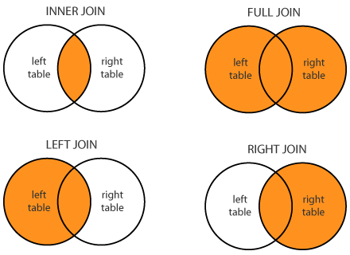
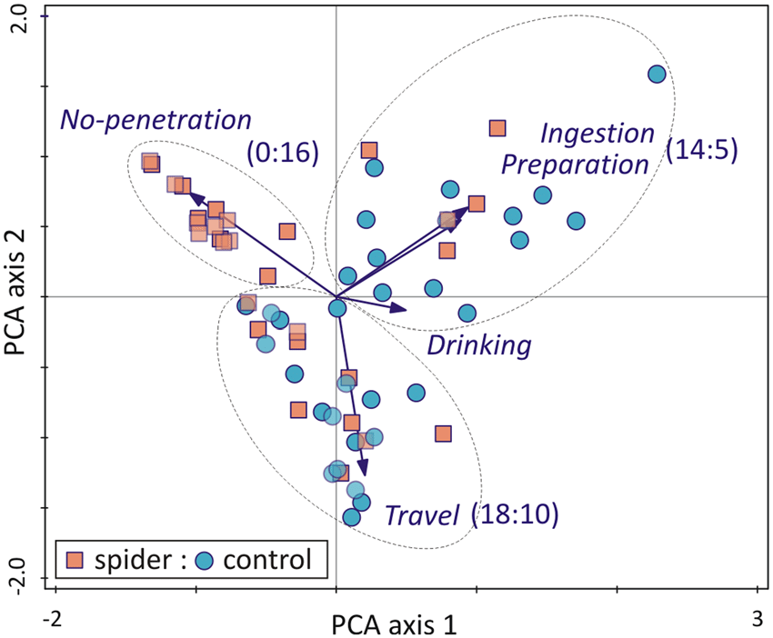
Fitting the Data to the Model
Cleaning and Editing Data
Cleaning up Unnecessary or Non-Informational Data
Fixing wrong data
Combining data from different sources
Determining Data Types
Date, Numeric, Text etc. checking data in formats
Performing appropriate data type conversions
Data Size Reduction
PCA
Elimination of redundant columns and correlation analysis
Examination of data distributions and regularization
Min-max Scaling
Standardization

Slide 24
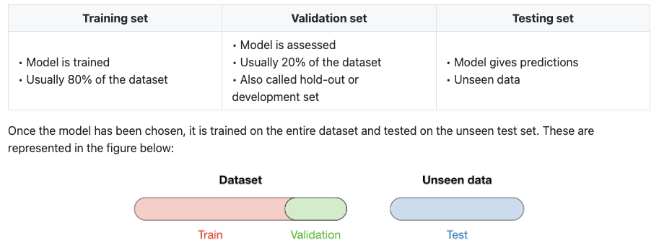
Model selection and training of the model

Slide 25
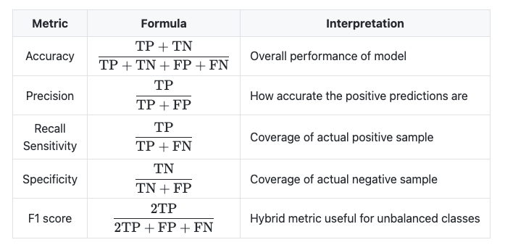
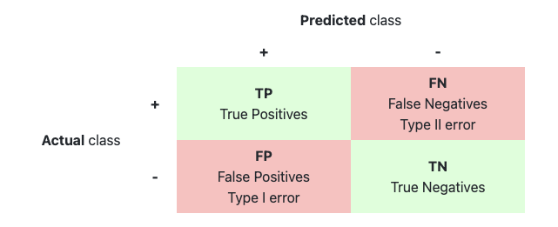
Success Performances: Classification Metrics
Complexity Matrix

Slide 26
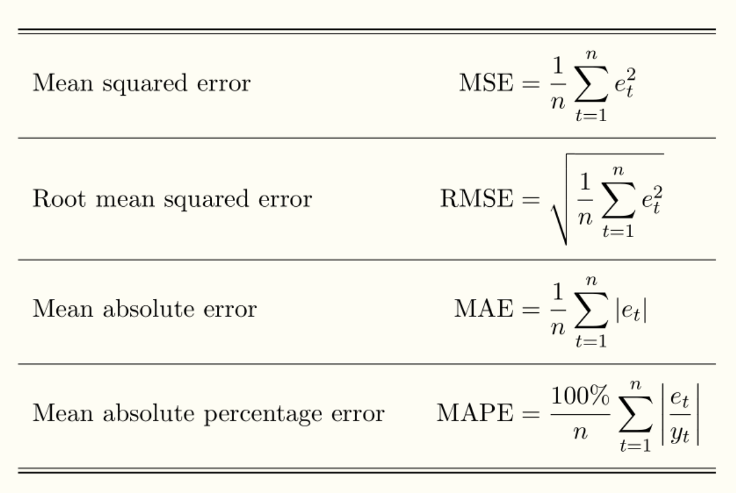
Success Performances: Regression Metrics

Slide 27
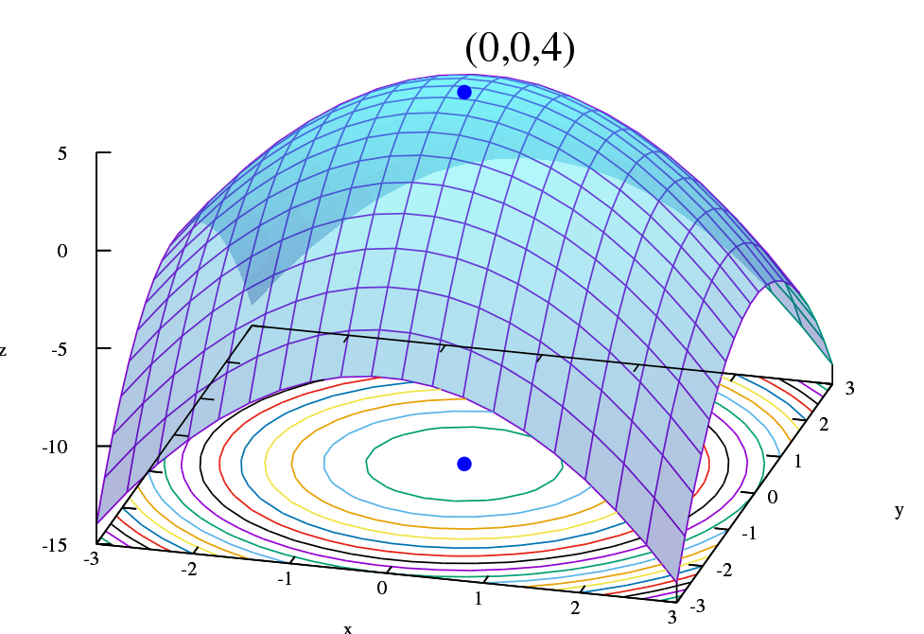
Optimizing the model
Fine tune hyperparameters using cross validation
Perform hyperparameter searches, gridsearch etc.
Try Ensemble methods. Combining your best models often performs better than running them individually
You'll want to use as much data as possible for this step, especially as you move towards the end of the tweak.
Once you are sure of your final model, measure its performance on the test set to estimate its generalization error.

Slide 28



Integrating the model into the system(Deployment)
ML Deployment is the integration of a data-driven machine learning model into an existing production environment.
The machine learning project developed in the test environment is made ready to work on platforms such as web services (SaaS, PaaS) in order to serve the end user.
Streamlit, HTML or CSS etc. It is an open source python library that helps you create interactive web applications without knowledge of it.
Docker is by far one of the most popular ways for developers to containerize their code.
Heroku is a cloud computing application infrastructure service provider (PaaS)

Slide 29
Machine Learning Terminologies

Slide 30
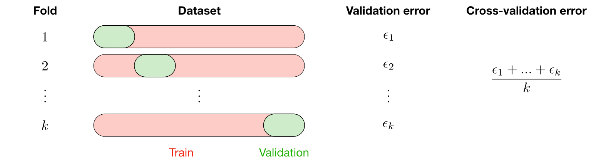
Cross Validation
Cross validation, also called CV, is a method used to select a model that does not rely heavily on the initial training set.

Slide 31
Bias - Variance Tradeoff
Bias: The bias of a model is the difference between the expected prediction and the correct model we are trying to predict for the given data points.
Varyans: The variance of a model is the variability of the model estimate for given data points.
Deviation/variance Tradeoff: The simpler the model, the higher the bias, and the more complex the model, the higher the variance.
 | Underfitting | Ideal | Overfitting
Symptoms | Higher training error Training error close to test error High bias | Training error slightly lower than test error | Very low training error Training error is considerably lower than test error High variance

Slide 32
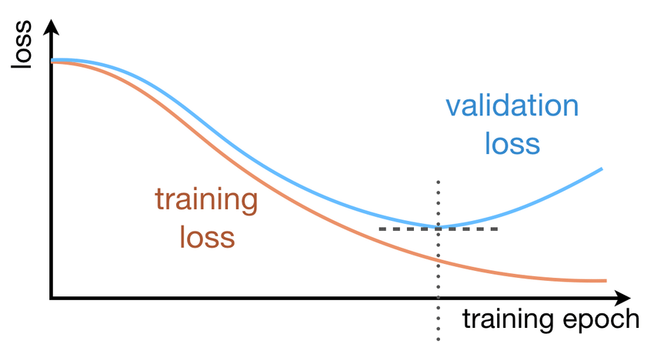
Early Stopping

Slide 33
Tools Used in Machine Learning

Slide 34

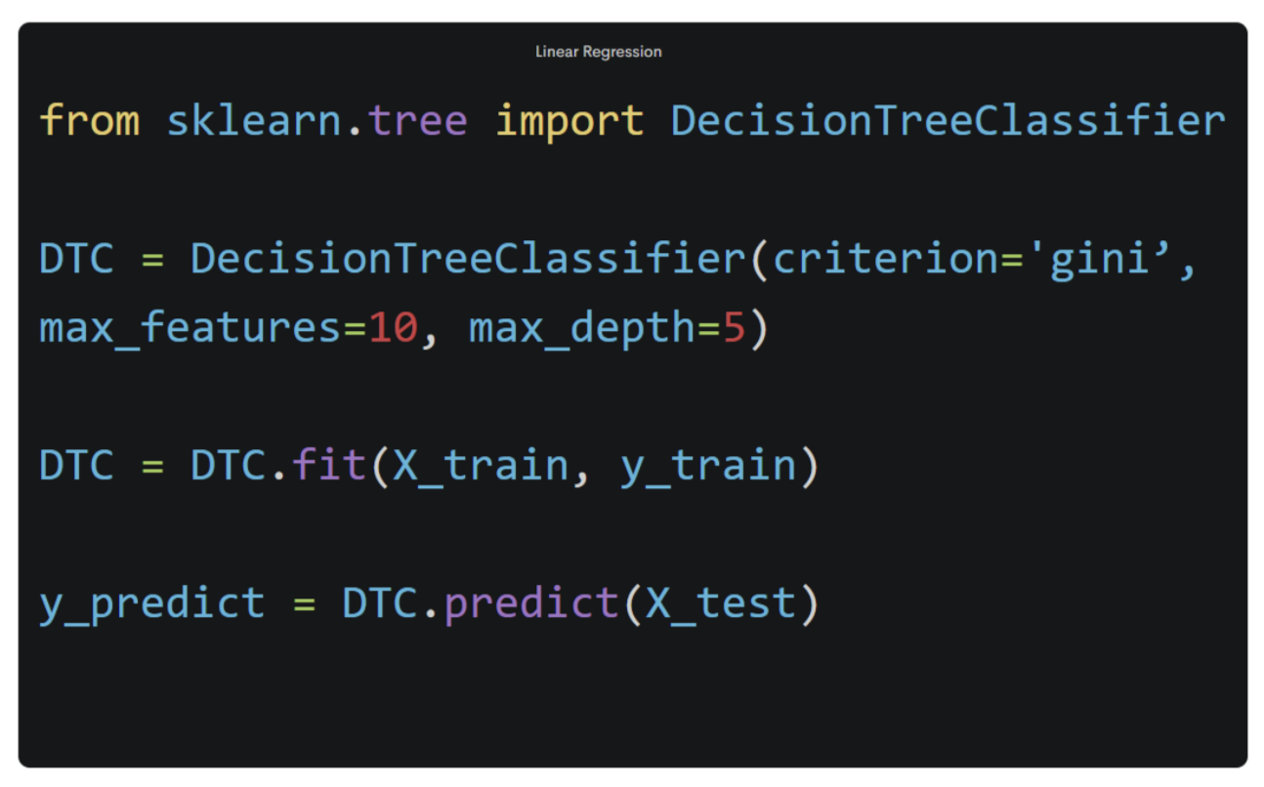
Tools Used in Machine Learning
Python is a general purpose programming language.
As an interpreted and dynamic language, Python mainly supports object-oriented programming approaches and functional programming.
Rapid prototyping
Basic Syntax
Easy to use
Large Community

Slide 35
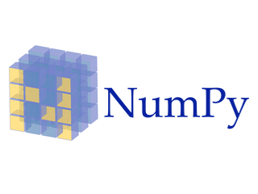
Tools Used in Machine Learning
NumPy is the basic package used for scientific calculations in Python.
Creating an array
Vectorization and slicing
Matrices and simple linear algebra
Data files

Slide 36

Tools Used in Machine Learning
Pandas is an open source Python library that facilitates data analysis and data preprocessing.
Useful functions for data manipulation
Tools to read and write data between different formats: CSV and text files, Microsoft Excel, SQL databases
Fast data visualization at a simple level

Slide 37
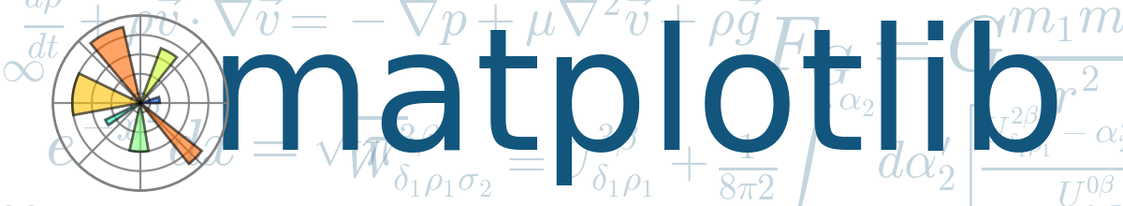
Tools Used in Machine Learning
Matplotlib is a data visualization and plotting library for the Python programming language
The matplotlib plotting package is one of the most important tools for scientific programming with Python
Matplotlib is a very powerful library. Can visualize data interactively
We can produce high quality outputs suitable for printing and publication.
Both two-dimensional and three-dimensional graphics can be produced

Slide 38
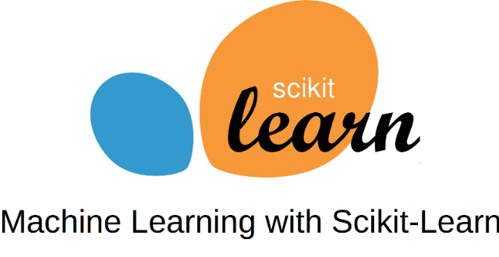
Tools Used in Machine Learning
Scikit-learn is a free software machine learning library for the Python programming language.
It includes many basic methods such as linear regression, logistic regression, decision trees, random forest.
https://scikit-learn.org/stable/

Slide 39
Datasets

Slide 40

Kaggle
Kaggle is an online community for data scientists and machine learning practitioners.
It is a platform where owners of large or small problems express their data and problems in order to solve the relevant problem, and the participants participate in competitions to solve the problem within the information given.
Hundreds of datasets
Prize competitions
Education and guides

Slide 41

UCI
UCI is the dataset repository provided by the machine learning and intelligent systems research center at the University of California, Irvine.
It currently hosts 588 datasets as a service to the machine learning community.
https://archive.ics.uci.edu/ml/index.php

